Slide 1
CIS 530 Computational Linguistics Mondays and Wednesdays 1:30-3pm 3401 Walnut, room 401B
http://computational-linguistics-class.org
Professor Callison-Burch

Slide 2

Professor Callison-Burch (not Professor Burch)
Bachelors from Stanford
PhD from University of Edinburgh
6 years at Johns Hopkins University
Joined Penn faculty in 2013
I have been working in the field of NLP since 2000. In 2017, I was the general chair of the 55th meeting of the ACL.
Notes:
I’m well-connected with the NLP community, and I hope to invite a lot of researchers to give guest lecturers about their research.

Slide 3

Notes:
Fantastic set of TAs who took the course last year.

Slide 4
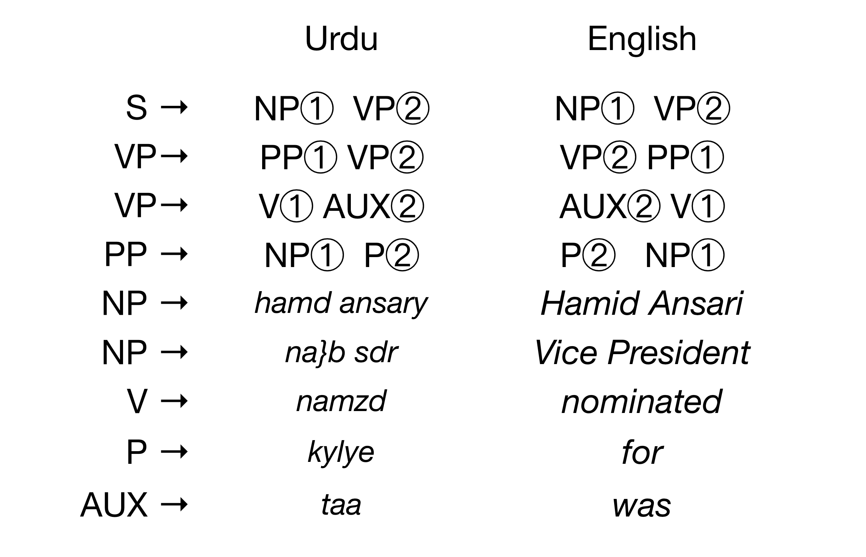
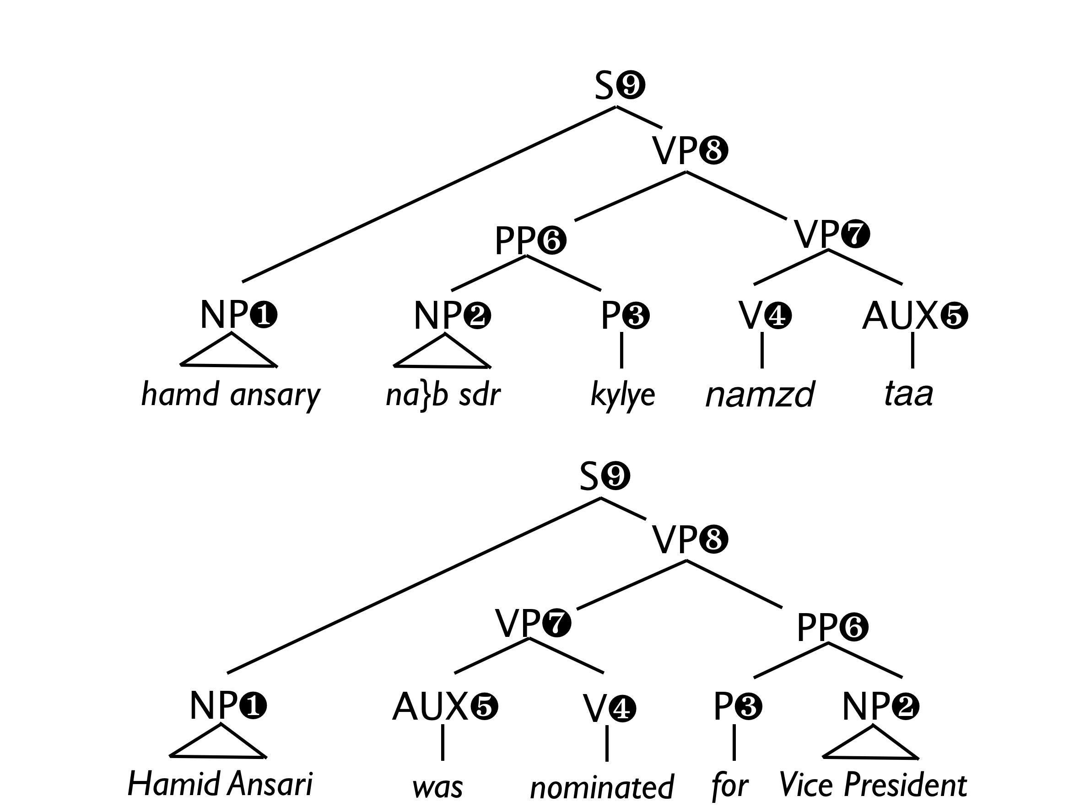

Slide 6
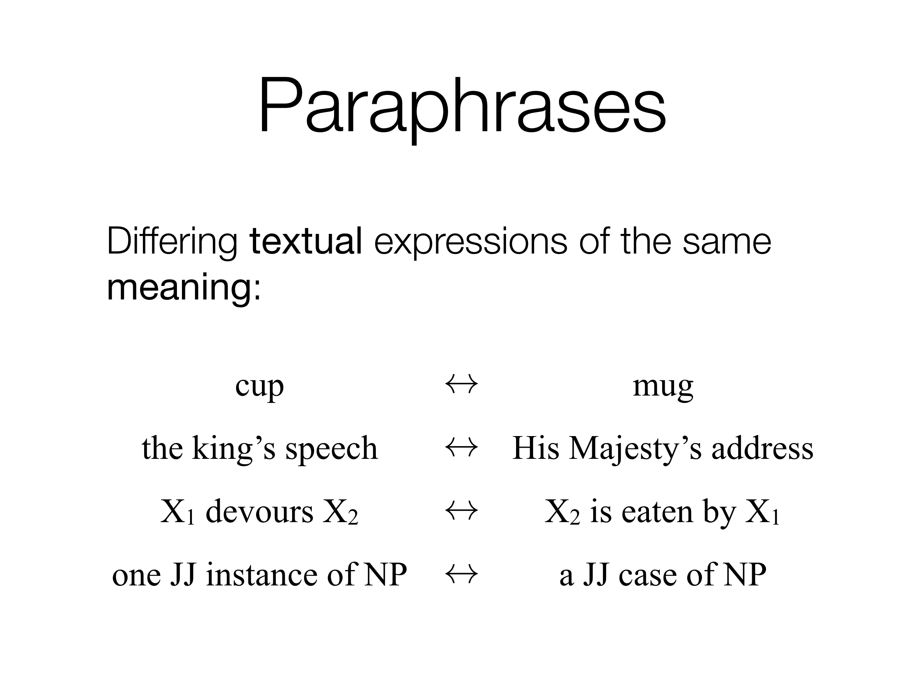

Slide 7
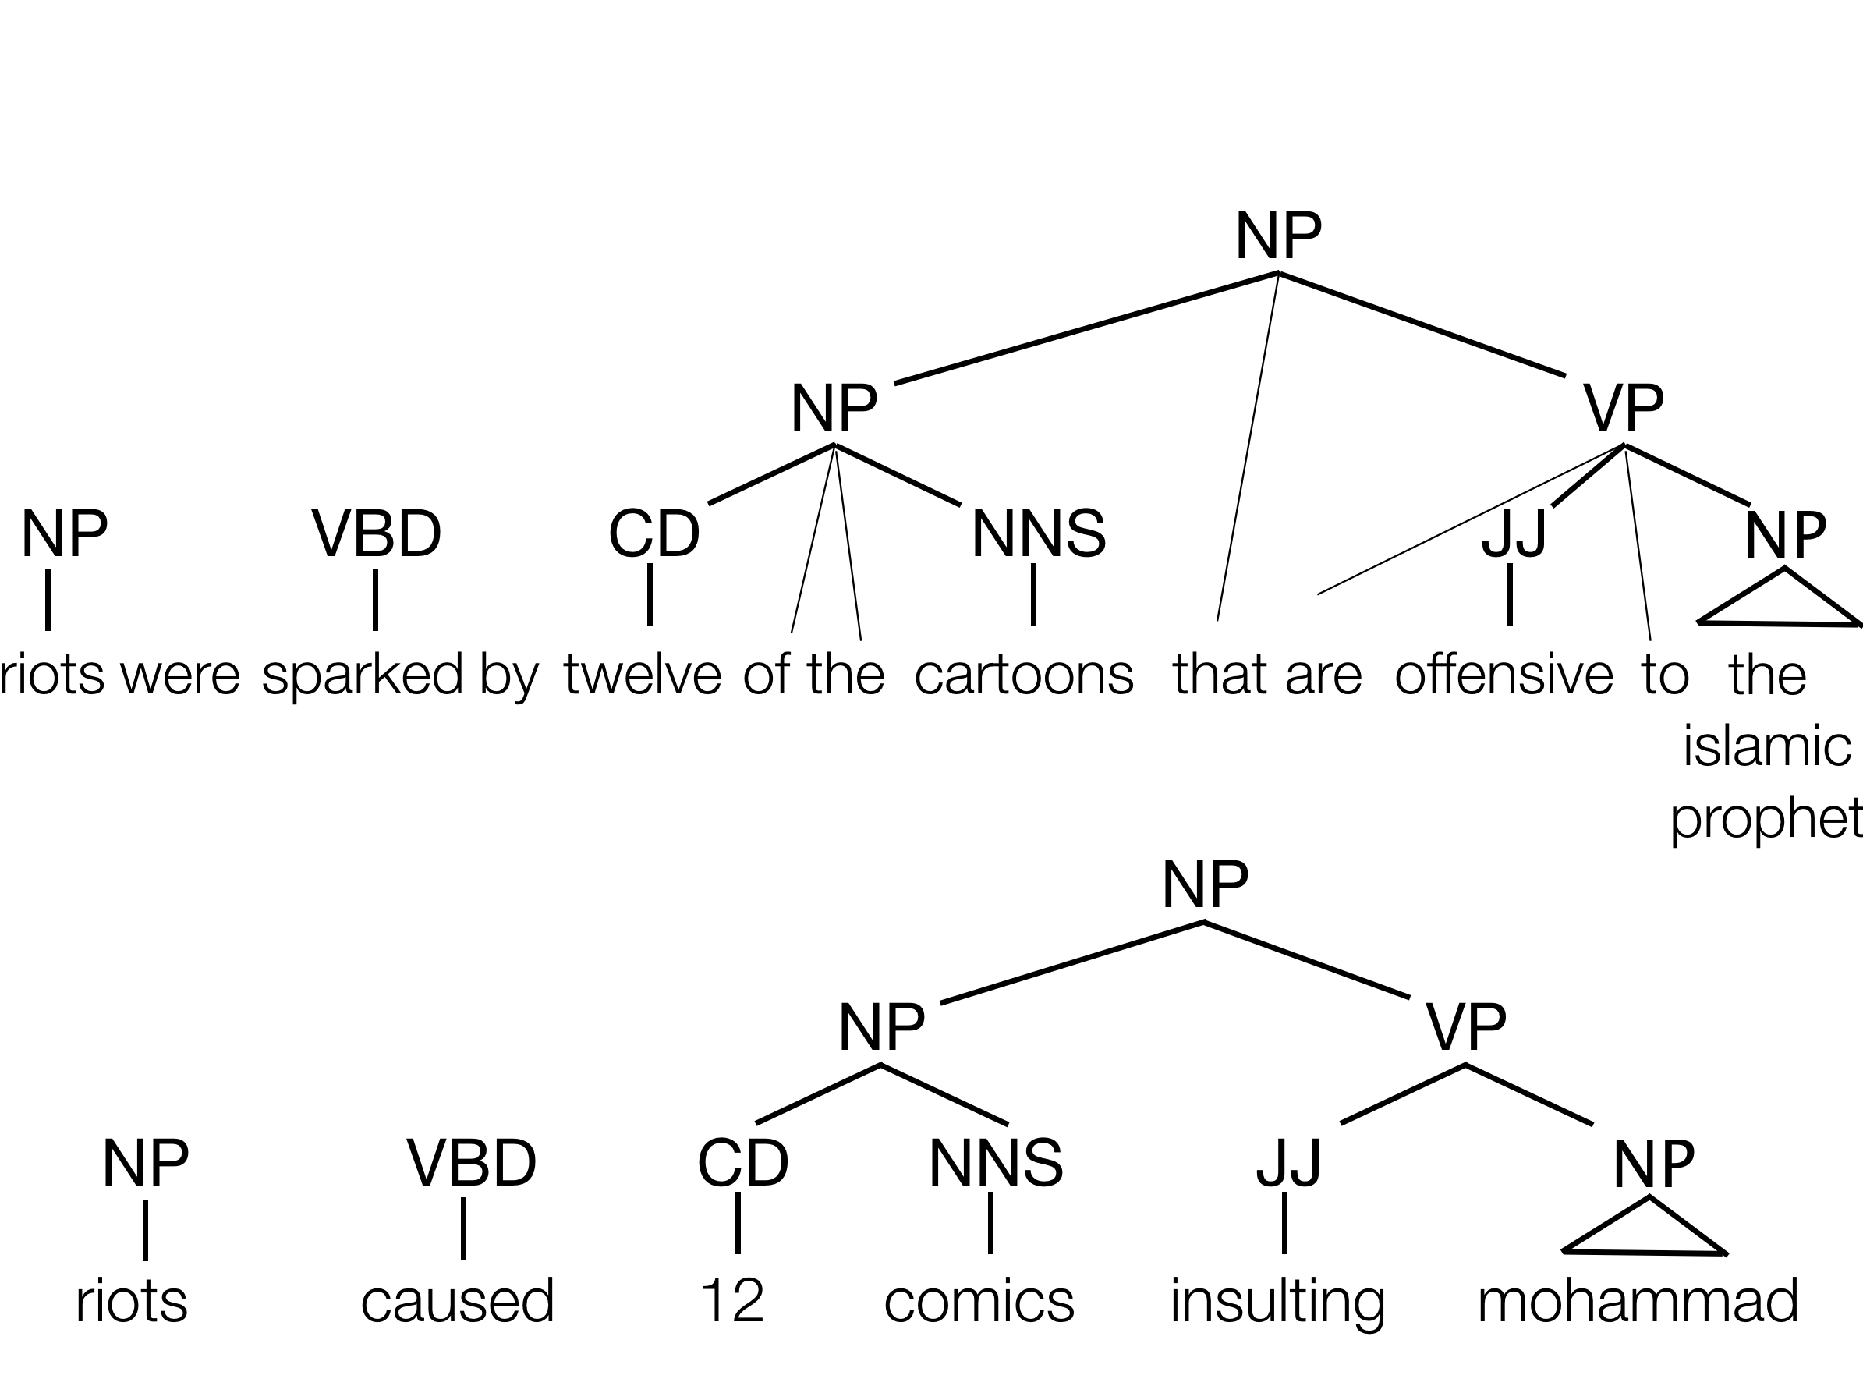
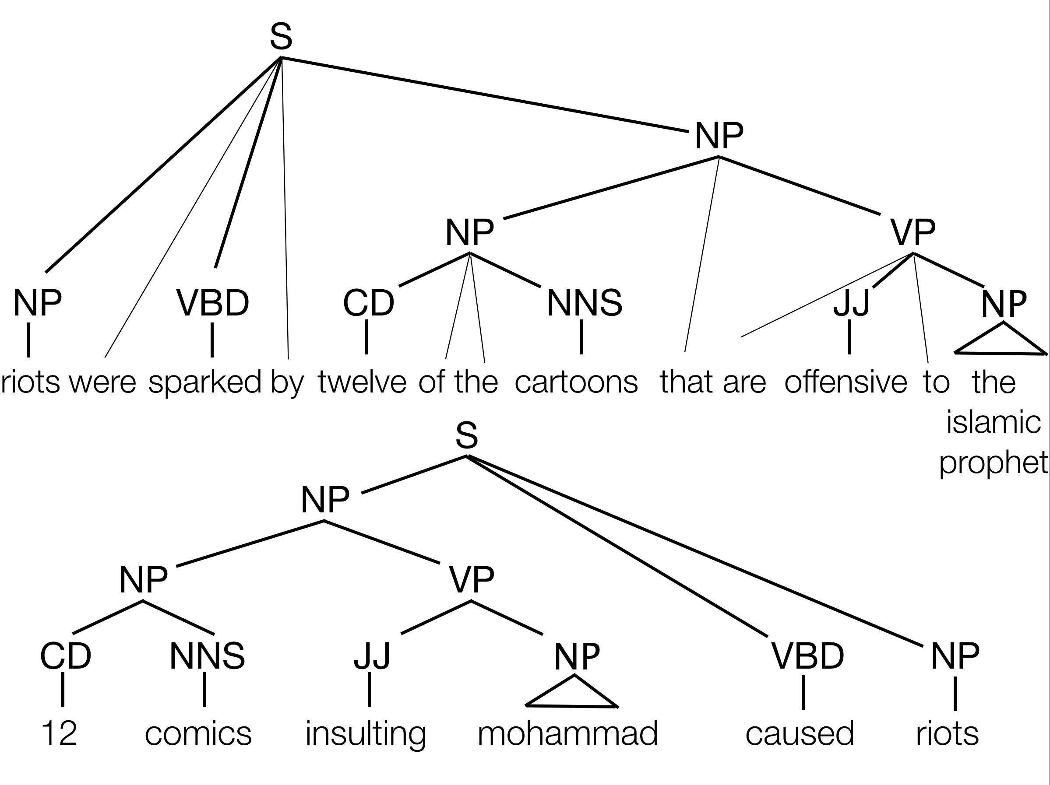

Slide 8
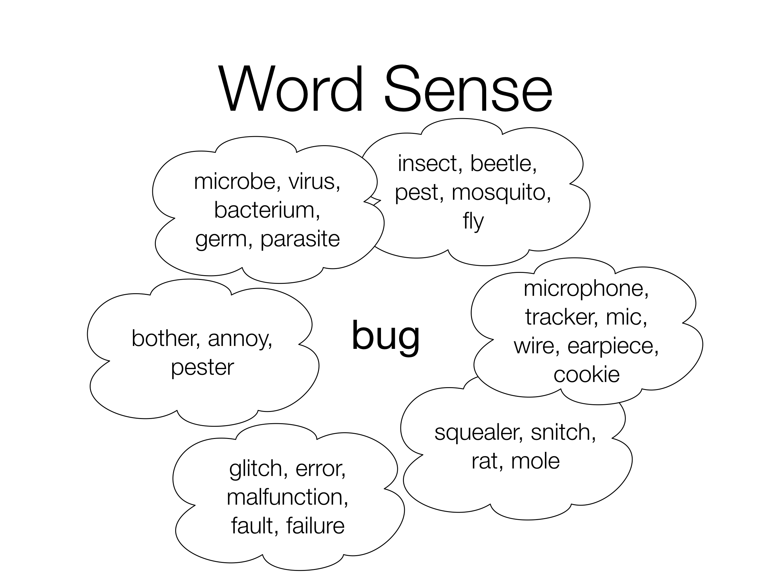

Slide 9
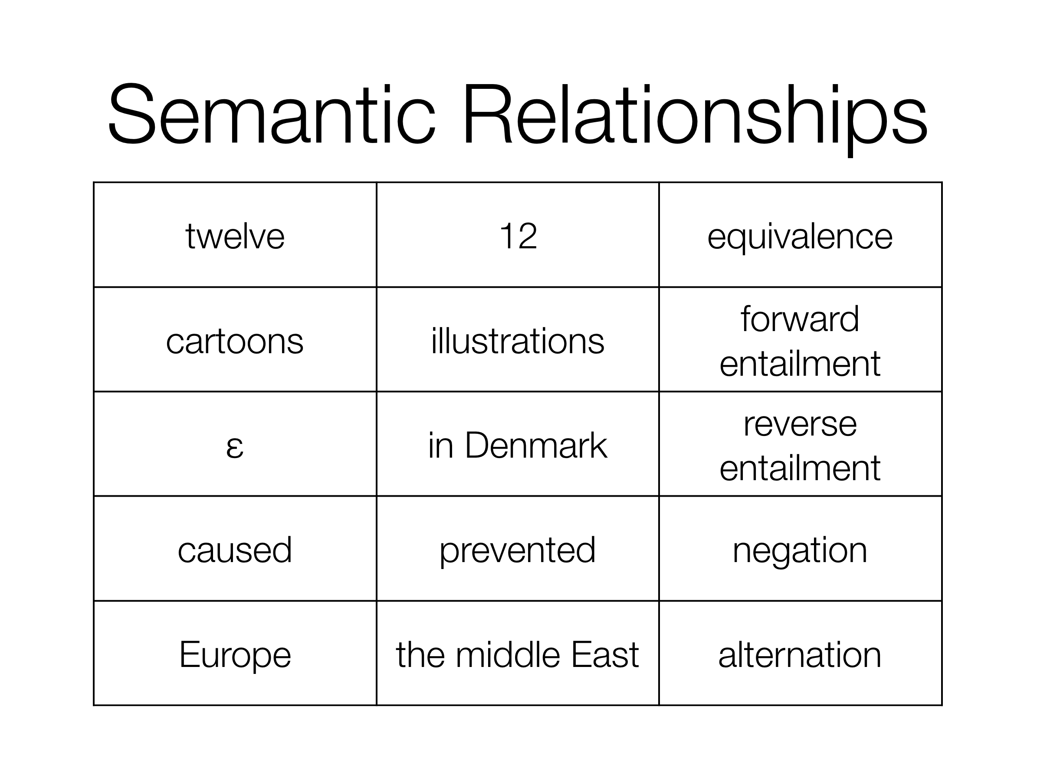

Slide 10
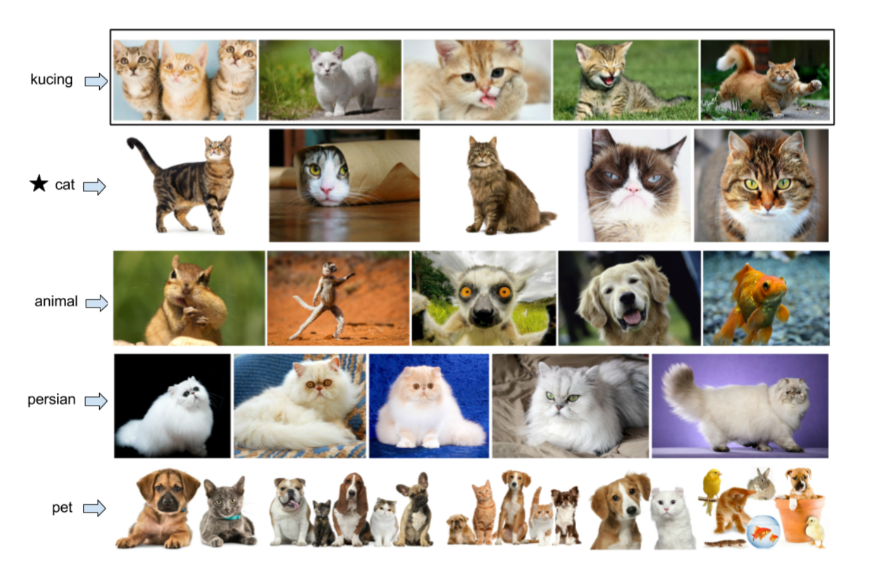

Slide 11
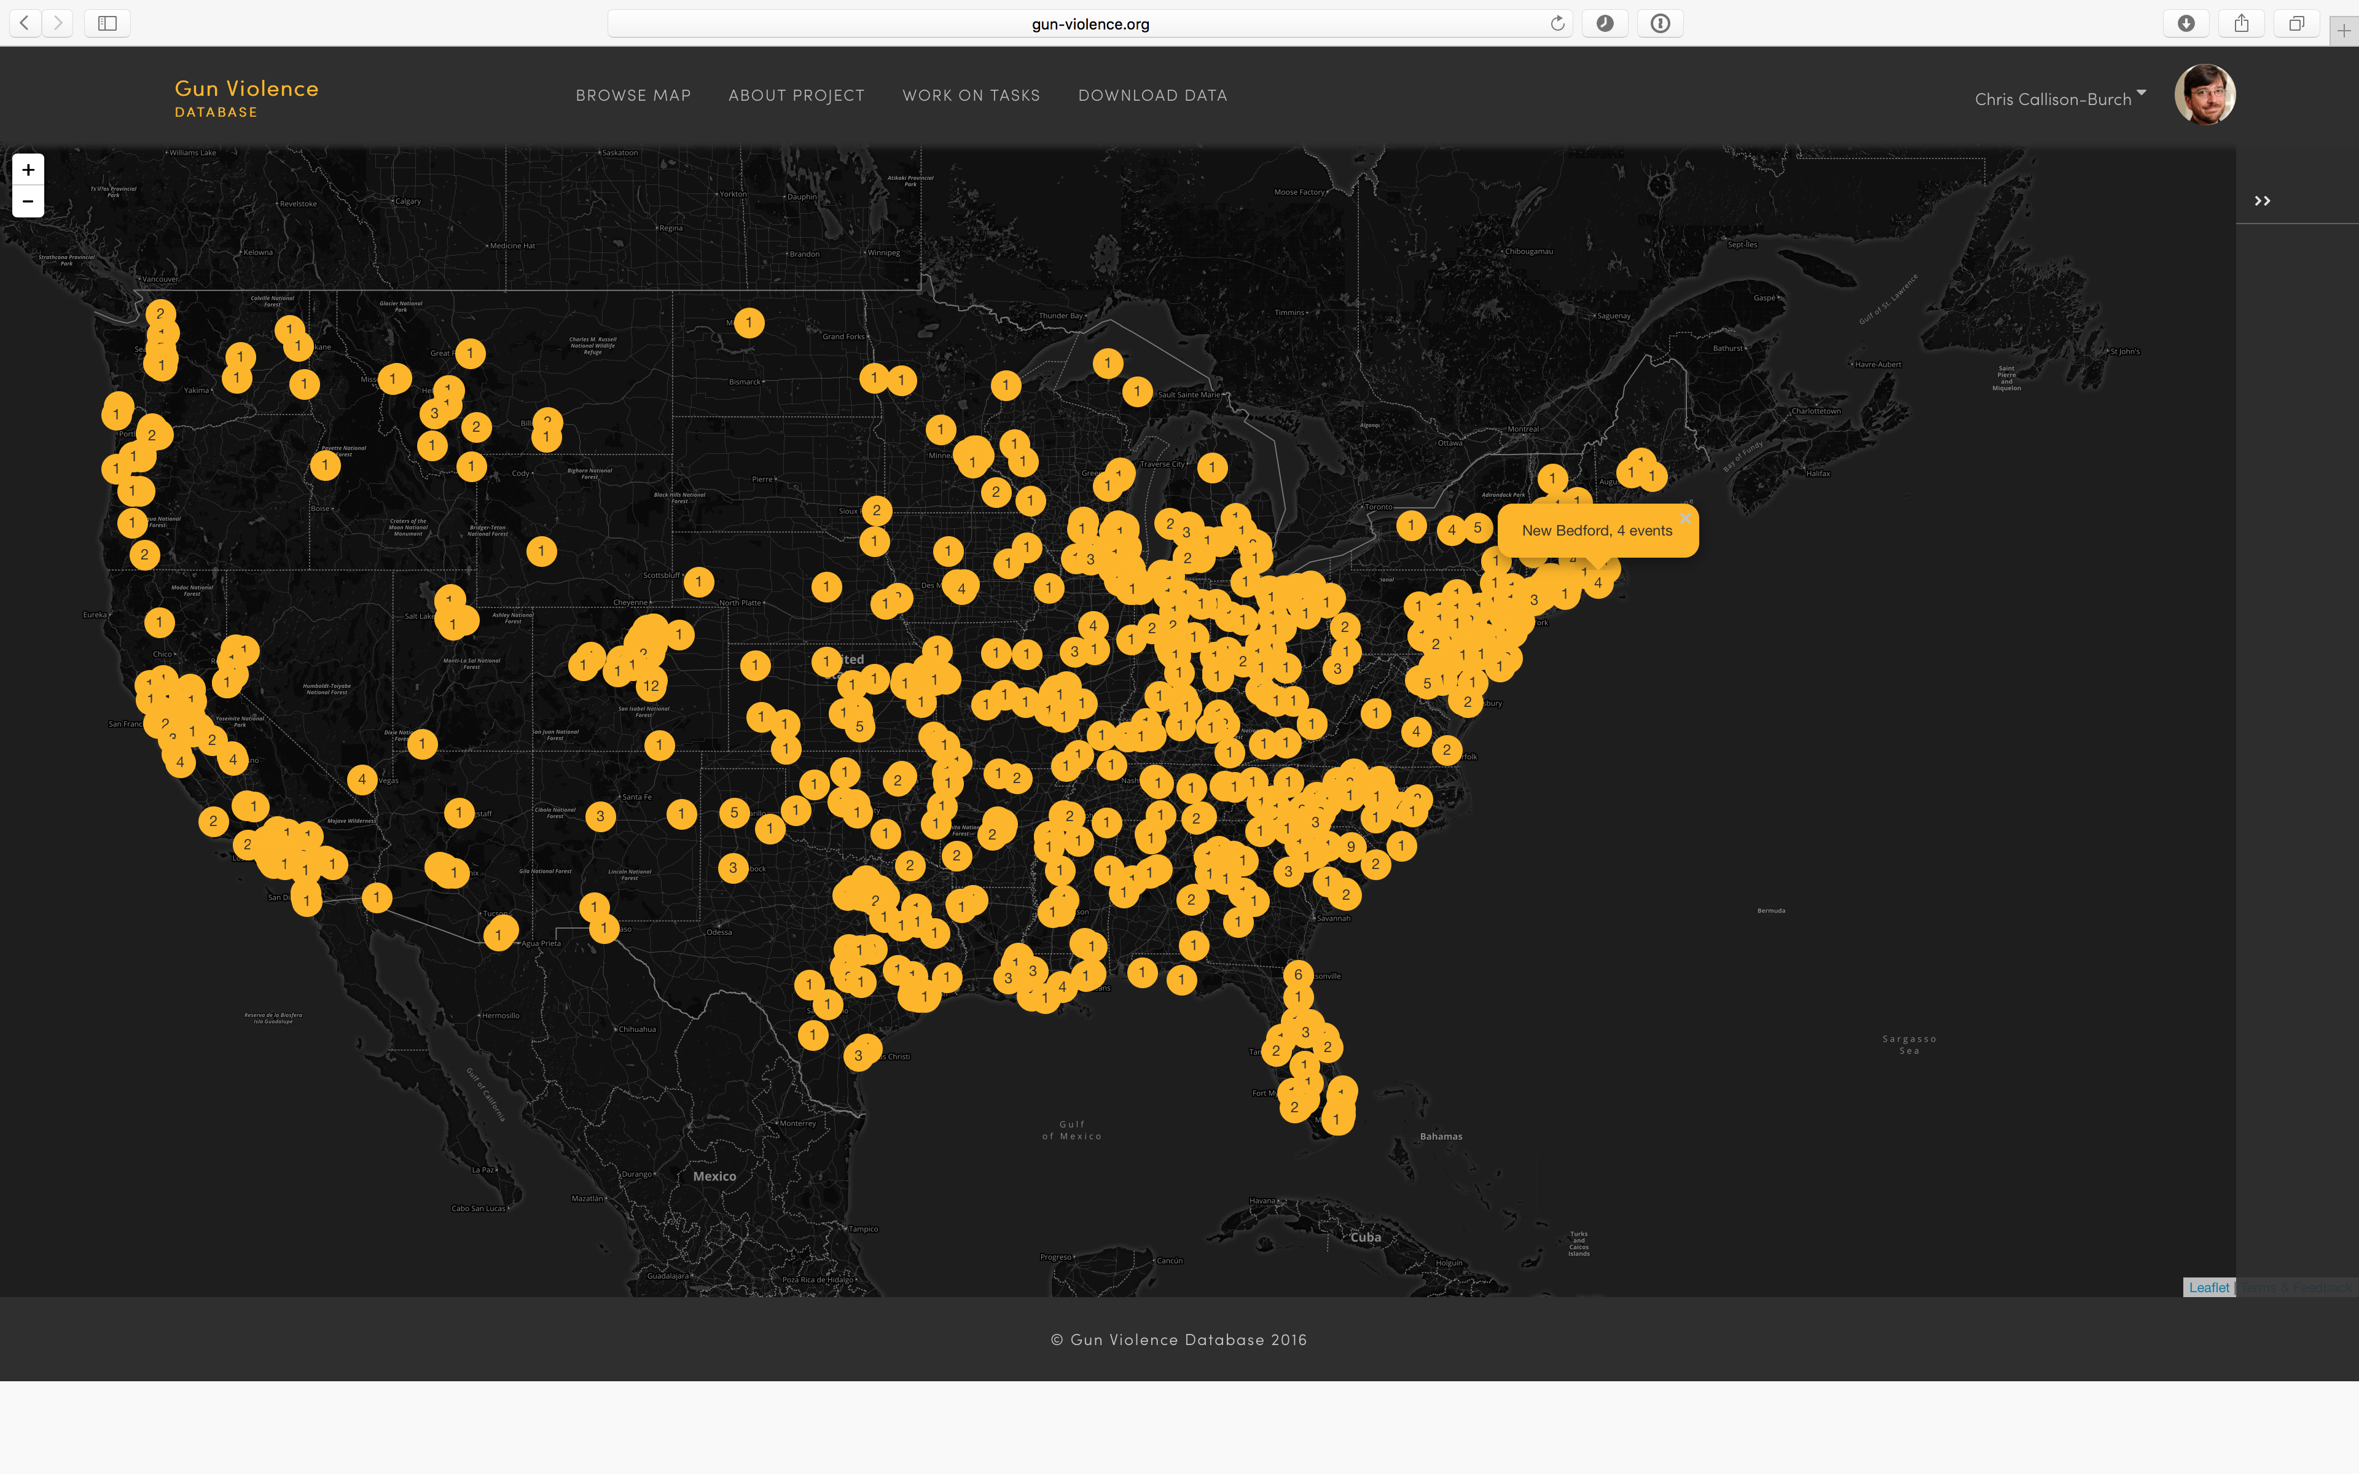
The Gun Violence Database
\\
Notes:
Goals of the GVDB
Collect data about gun violence in the US to facilitate public health research
Use machine learning and crowdsourcing to extract structured data from text

Slide 12
Information Extraction
Chicago Police release Laquan McDonald shooting video | National News
Person #1014
Name | Laquan McDonald
Gender
Age
Race
Three seconds. On a dashcam video clock, that's the amount of time between the moment when two officers have their guns drawn and the point when Laquan McDonald falls to the ground. The video, released to the public for the first time late Tuesday, is a key piece of evidence in a case that's sparked protests in Chicago and has landed an officer behind bars. The 17-year-old McDonald was shot 16 times on that day the video shows in October 2014. Chicago police Officer Jason Van Dyke was charged Tuesday with first-degree murder….
Incident #1053
City
Date
Shooter
Victim | McDonald
Victim Killed

Slide 13
What will you learn?
This will be a survey class in natural language processing
Focus will be programming assignments for hands-on learning
Topics will include things like
Sentiment analysis
Vector space semantics
Machine translation
Information extraction

Slide 14
Course textbook
Don’t buy this book!
The Authors are releasing free draft chapters of their updated 3rd edition.
https://web.stanford.edu/~jurafsky/slp3/
We will use the draft 3rd edition as our course textbook, along with required reading of research papers.

Slide 15
Course Grading
Weekly programming assignments
Short quizzes on the assigned readings
Self-designed final project
No final exam or midterm
All homework assignments can be done in pairs, except for HW1
Final project will be teams of ~4-5
5 free late days for the term (1 minute - 24 hours = 1 day late)

Slide 16
Text Classification and Sentiment Analysis
Slides from Speech and Language Processing (3rd ed. draft) by Dan Jurafsky and James H. Martin

Slide 17


Positive or negative movie review?
unbelievably disappointing
Full of zany characters and richly applied satire, and some great plot twists
this is the greatest screwball comedy ever filmed
It was pathetic. The worst part about it was the boxing scenes.

Slide 18
What is the subject of this article?
MEDLINE Article
MeSH Subject Category Hierarchy
Antogonists and Inhibitors
Blood Supply
Chemistry
Drug Therapy
Embryology
Epidemiology
…
?
Notes:
Medical Subject Headings (MeSH) is a comprehensive controlled vocabulary for the purpose of indexing journal articles and books in the life sciences; it serves as a thesaurus that facilitates searching. Created and updated by the United States National Library of Medicine (NLM), it is used by the MEDLINE/PubMed article database and by NLM's catalog of book holdings. MeSH is also used by ClinicalTrials.gov registry to classify which diseases are studied by trials registered in ClinicalTrials.gov.

Slide 19
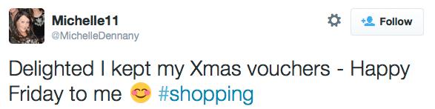


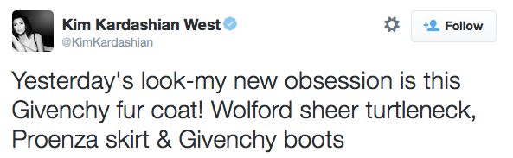
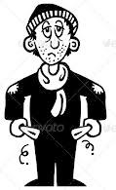

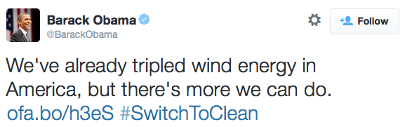


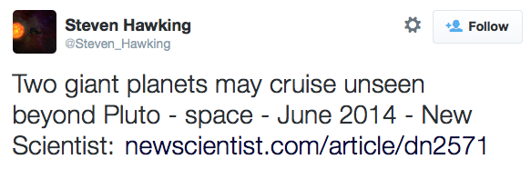


Classify User Attributes Using Their Tweets
?
?
?
?
Slide from Svitlana Volkova
Notes:
The signal that can reveal user attributes is in their language.

Slide 20
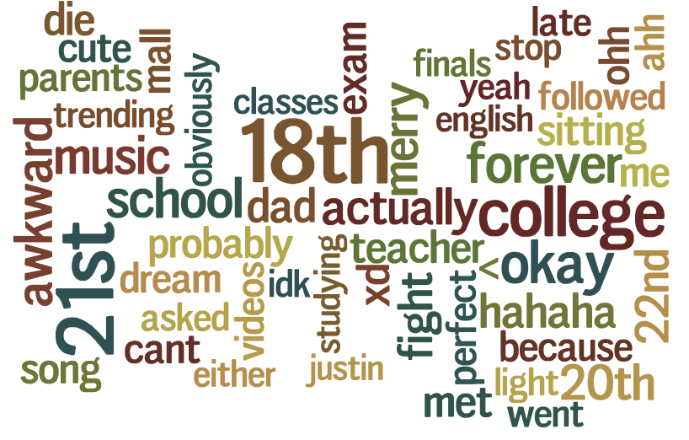

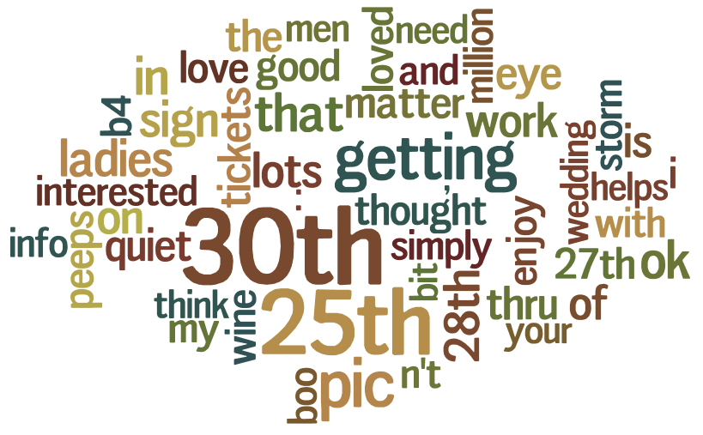

Lexical Markers for Age
Slide from Svitlana Volkova

Slide 21
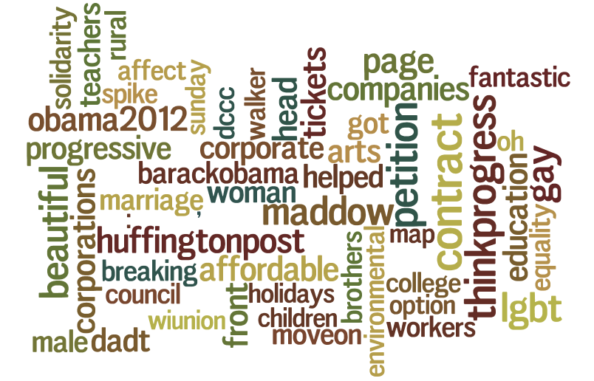

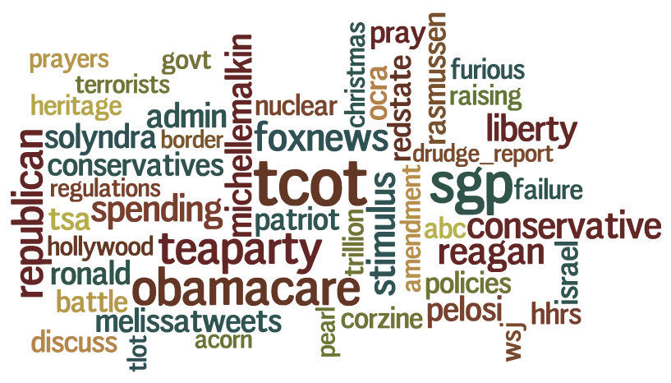

Lexical Markers for Political Preferences
Slide from Svitlana Volkova

Slide 22

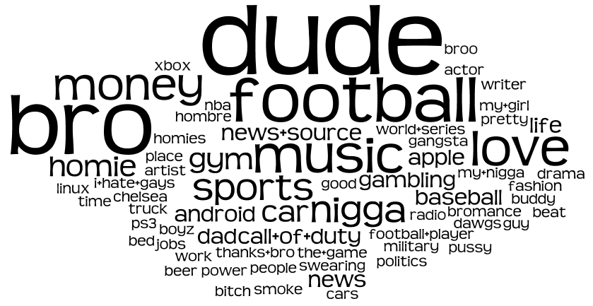
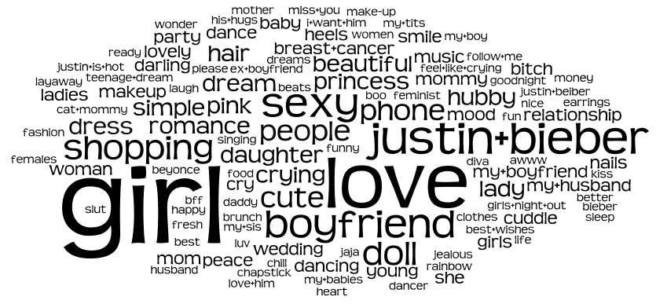

Lexical Markers for Gender
Slide from Svitlana Volkova

Slide 23
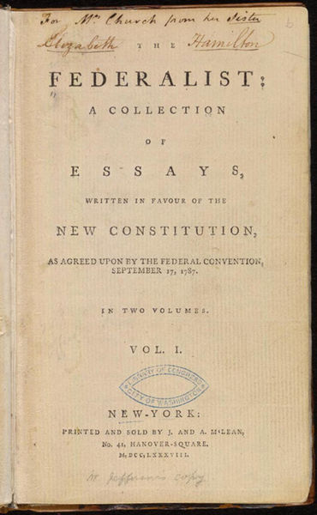
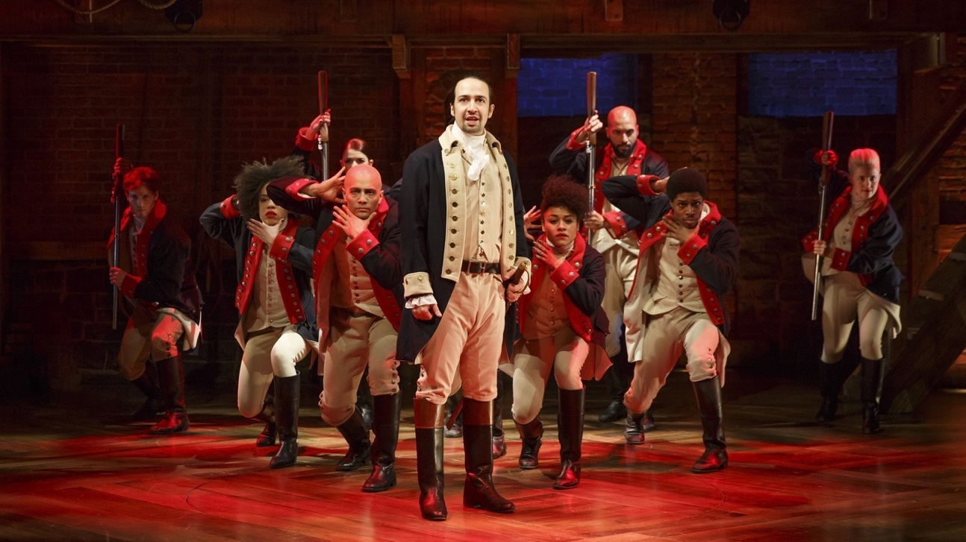
Who wrote which Federalist papers?
1787-8: anonymous essays try to convince New York to ratify U.S Constitution: Jay, Madison, Hamilton.
Authorship of 12 of the letters in dispute
1963: solved by Mosteller and Wallace using Bayesian methods
James Madison
Alexander Hamilton

Slide 24



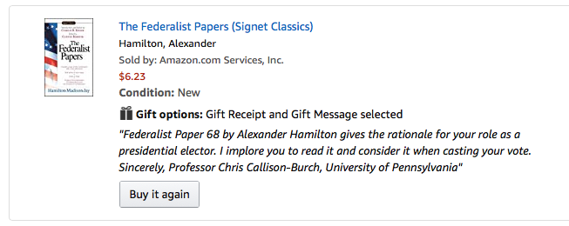
Notes:
I sent a copy to each of Pennsylvania’s 20 electors in 2016.

Slide 25
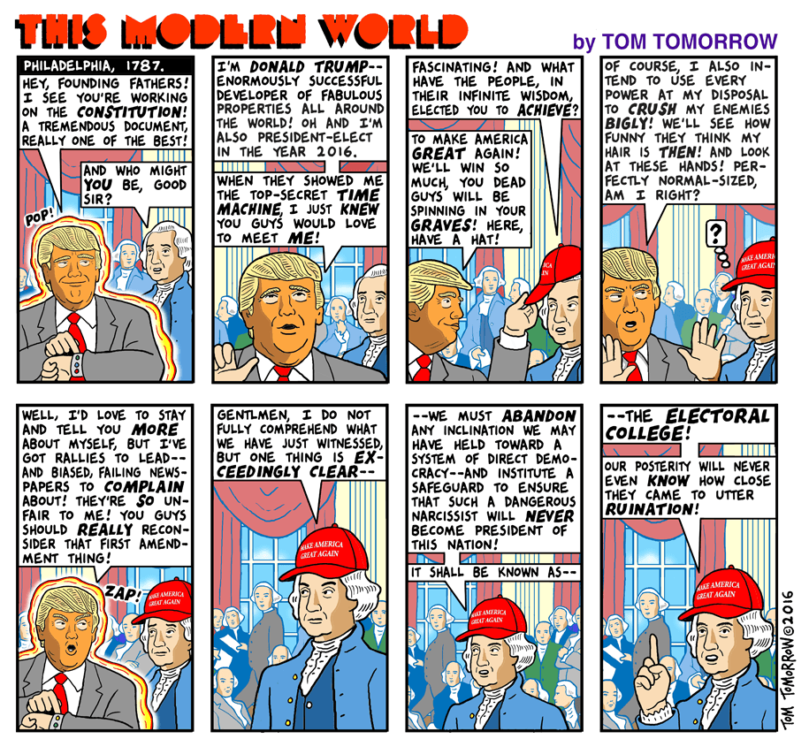

Slide 26
Text Classification
Assigning subject categories, topics, or genres
Spam detection
Authorship identification
Age/gender identification
Language Identification
Sentiment analysis
…

Slide 27
Sentiment Analysis
What is Sentiment Analysis?

Slide 28
Positive or negative movie review?
unbelievably disappointing
Full of zany characters and richly applied satire, and some great plot twists
this is the greatest screwball comedy ever filmed
It was pathetic. The worst part about it was the boxing scenes.

Slide 29
Google Product Search
a

Slide 30
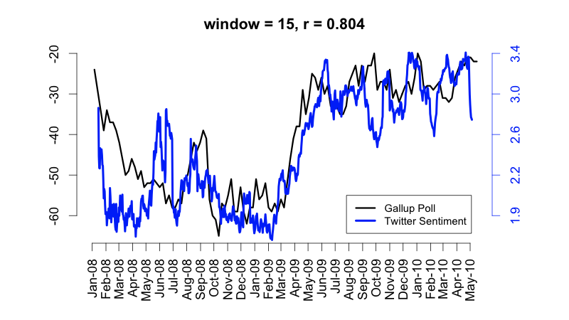
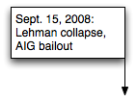
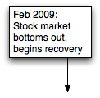
Twitter sentiment versus Gallup Poll of Consumer Confidence
Brendan O'Connor, Ramnath Balasubramanyan, Bryan R. Routledge, and Noah A. Smith. 2010. From Tweets to Polls: Linking Text Sentiment to Public Opinion Time Series. In ICWSM-2010
Notes:
From Tweets to Polls: Linking Text Sentiment to Public Opinion Time Series in International Conference on Weblogs and Social Media (ICWSM)
Abstract: We connect measures of public opinion measured from polls with sentiment measured from text. We analyze several surveys on consumer confidence and political opinion over the 2008 to 2009 period, and find they correlate to sentiment word frequencies in contempora- neous Twitter messages. While our results vary across datasets, in several cases the correlations are as high as 80%, and capture important large-scale trends. The re- sults highlight the potential of text streams as a substi- tute and supplement for traditional polling.

Slide 31
Twitter sentiment:
Johan Bollen, Huina Mao, Xiaojun Zeng. 2011. Twitter mood predicts the stock market,
Journal of Computational Science 2:1, 1-8. 10.1016/j.jocs.2010.12.007.
Notes:
Abstract: Abstract—Behavioral economics tells us that emotions can profoundly affect individual behavior and decision-making. Does this also apply to societies at large, i.e. can societies experience mood states that affect their collective decision making? By extension is the public mood correlated or even predictive of economic indicators? Here we investigate whether measurements of collective mood states derived from large-scale Twitter feeds are correlated to the value of the Dow Jones Industrial Average (DJIA) over time. We analyze the text content of daily Twitter feeds by two mood tracking tools, namely OpinionFinder that measures positive vs. negative mood and Google-Profile of Mood States (GPOMS) that measures mood in terms of 6 dimensions (Calm, Alert, Sure, Vital, Kind, and Happy). We cross-validate the resulting mood time series by comparing their ability to detect the public’s response to the presidential election and Thanksgiving day in 2008. A Granger causality analysis and a Self-Organizing Fuzzy Neural Network are then used to investigate the hypothesis that public mood states, as measured by the OpinionFinder and GPOMS mood time series, are predictive of changes in DJIA closing values. Our results indicate that the accuracy of DJIA predictions can be significantly improved by the inclusion of specific public mood dimensions but not others. We find an accuracy of 87.6% in predicting the daily up and down changes in the closing values of the DJIA and a reduction of the Mean Average Percentage Error by more than 6%.
Thanks to Johan Bollen (email, 1/18/12) for permission to use this figure.

Slide 32
Bollen et al. (2011)
CALM predicts DJIA 3 days later
At least one current hedge fund uses this algorithm
Dow Jones
CALM
Notes:
Thanks to Johan Bollen (email, 1/18/12) for permission to use this figure.

Slide 33
Target Sentiment on Twitter

Slide 34
Sentiment analysis has many other names
Opinion extraction
Opinion mining
Sentiment mining
Subjectivity analysis

Slide 35
Why sentiment analysis?
Movie: is this review positive or negative?
Products: what do people think about the new iPhone?
Public sentiment: how is consumer confidence? Is despair increasing?
Politics: what do people think about this candidate or issue?
Prediction: predict election outcomes or market trends from sentiment

Slide 36
Scherer Typology of Affective States
Emotion: brief organically synchronized … evaluation of a major event
angry, sad, joyful, fearful, ashamed, proud, elated
Mood: diffuse non-caused low-intensity long-duration change in subjective feeling
cheerful, gloomy, irritable, listless, depressed, buoyant
Interpersonal stances: affective stance toward another person in a specific interaction
friendly, flirtatious, distant, cold, warm, supportive, contemptuous
Attitudes: enduring, affectively colored beliefs, dispositions towards objects or persons
liking, loving, hating, valuing, desiring
Personality traits: stable personality dispositions and typical behavior tendencies
nervous, anxious, reckless, morose, hostile, jealous
Scherer, Klaus R. 1984. Emotion as a Multicomponent Process: A model and some cross-cultural data.
In Review of Personality and Social Psych 5: 37-63.
Notes:
Social Psychology has categorized affective states into many different dimensions. [Read them]
NLP focuses on Attitudes for sentiment analysis
Info from Sentiment Symposium Tutorial: Language and cognition by Chris Potts http://sentiment.christopherpotts.net/lingcog.html
Abstract
The author discusses the steps in the development of his component process model (CPM) of emotions. In 1981 he proposed a formal model to extend the original idea about the role of the stimulus evaluation factors in differentiating emotional states to a sequence model. This model states that the differentiated emotional states are the result of the successive outcomes of a series of stimulus evaluation checks. A CPM of emotion was then developed. The CPM postulates 5 functionally defined subsystems of an organism that are centrally involved in the emotional process: information processing, support, executive, action, and monitoring. Differences between this theory and discrete emotion theory are discussed, and the CPM is used to account for the semantic structure of natural language emotion terms. Two studies, involving 10 Ss who sorted emotion terms and 636 students who completed a questionnaire on situations that provoke emotional arousal, are cited, and results concerning antecedents and reactions are noted. (38 ref) (PsycINFO Database Record (c) 2016 APA, all rights reserved)

Slide 37
Scherer Typology of Affective States
Emotion: brief organically synchronized … evaluation of a major event
angry, sad, joyful, fearful, ashamed, proud, elated
Mood: diffuse non-caused low-intensity long-duration change in subjective feeling
cheerful, gloomy, irritable, listless, depressed, buoyant
Interpersonal stances: affective stance toward another person in a specific interaction
friendly, flirtatious, distant, cold, warm, supportive, contemptuous
Attitudes: enduring, affectively colored beliefs, dispositions towards objects or persons
liking, loving, hating, valuing, desiring
Personality traits: stable personality dispositions and typical behavior tendencies
nervous, anxious, reckless, morose, hostile, jealous

Slide 38
Sentiment Analysis
Sentiment analysis is the detection of attitudes
“enduring, affectively colored beliefs, dispositions towards objects or persons”
Holder (source) of attitude
Target (aspect) of attitude
Type of attitude
From a set of types
Like, love, hate, value, desire, etc.
Or (more commonly) simple weighted polarity:
positive, negative, neutral, together with strength
Text containing the attitude
Sentence or entire document

Slide 39
Sentiment Analysis
Simplest task:
Is the attitude of this text positive or negative?
More complex:
Rank the attitude of this text from 1 to 5
Advanced:
Detect the target, source, or complex attitude types

Slide 40
Sentiment Analysis
Simplest task:
Is the attitude of this text positive or negative?
More complex:
Rank the attitude of this text from 1 to 5
Advanced:
Detect the target, source, or complex attitude types

Slide 41
Sentiment Analysis
A Baseline Algorithm

Slide 42
Sentiment Classification in Movie Reviews
Bo Pang, Lillian Lee, and Shivakumar Vaithyanathan. 2002. Thumbs up? Sentiment Classification using Machine Learning Techniques. EMNLP-2002, 79—86.
Bo Pang and Lillian Lee. 2004. A Sentimental Education: Sentiment Analysis Using Subjectivity Summarization Based on Minimum Cuts. ACL, 271-278
Polarity detection:
Is an IMDB movie review positive or negative?
Data: Polarity Data 2.0:
http://www.cs.cornell.edu/people/pabo/movie-review-data

Slide 43
IMDB data in the Pang and Lee database
✓
✗
when _star wars_ came out some twenty years ago , the image of traveling throughout the stars has become a commonplace image . […]
when han solo goes light speed , the stars change to bright lines , going towards the viewer in lines that converge at an invisible point .
cool .
_october sky_ offers a much simpler image–that of a single white dot , traveling horizontally across the night sky . [. . . ]
“ snake eyes ” is the most aggravating kind of movie : the kind that shows so much potential then becomes unbelievably disappointing .
it’s not just because this is a brian depalma film , and since he’s a great director and one who’s films are always greeted with at least some fanfare .
and it’s not even because this was a film starring nicolas cage and since he gives a brauvara performance , this film is hardly worth his talents .

Slide 44
Baseline Algorithm (adapted from Pang and Lee)
Tokenization
Feature Extraction
Classification using different classifiers
Naïve Bayes
MaxEnt
SVM
CRF
Neural net

Slide 45
Sentiment Tokenization Issues
Deal with HTML and XML markup
Twitter mark-up (names, hash tags)
Capitalization (preserve for
words in all caps)
Phone numbers, dates
Emoticons
Useful code:
Christopher Potts sentiment tokenizer
Brendan O’Connor twitter tokenizer
Potts emoticons
[<>]? # optional hat/brow
[:;=8] # eyes
[\-o\*\']? # optional nose
[\)\]\(\[dDpP/\:\}\{@\|\\] # mouth
| #### reverse orientation
[\)\]\(\[dDpP/\:\}\{@\|\\] # mouth
[\-o\*\']? # optional nose
[:;=8] # eyes
[<>]? # optional hat/brow

Slide 46
Extracting Features for Sentiment Classification
How to handle negation
I didn’t like this movie
vs
I really like this movie
Which words to use?
Only adjectives
All words
All words turns out to work better, at least on this data

Slide 47
Negation
Das, Sanjiv and Mike Chen. 2001. Yahoo! for Amazon: Extracting market sentiment from stock message boards. In Proceedings of the Asia Pacific Finance Association Annual Conference (APFA).
Bo Pang, Lillian Lee, and Shivakumar Vaithyanathan. 2002. Thumbs up? Sentiment Classification using Machine Learning Techniques. EMNLP-2002, 79—86.
Add NOT_ to every word between negation and following punctuation:
didn’t like this movie , but I
didn’t NOT_like NOT_this NOT_movie but I

Slide 48
Text Classification with Naïve Bayes
The Task of Text Classification

Slide 49
Text Classification: definition
Input:
a document d
a fixed set of classes C = {c₁, c₂,…, c_{J}}
Output: a predicted class c ∈ C

Slide 50
Naïve Bayes Intuition
Simple (“naïve”) classification method based on Bayes rule
Relies on very simple representation of document
Bag of words

Slide 51
The Bag of Words Representation

Slide 52
The bag of words representation
seen | 2
sweet | 1
whimsical | 1
recommend | 1
happy | 1
... | ...
γ(
)=c
Notes:
Gamma γ is a funciton

Slide 53
Bayes’ Rule Applied to Documents and Classes
For a document d and a class c

Slide 54
Naïve Bayes Classifier
MAP is “maximum a posteriori” = most likely class
Bayes Rule
Dropping the denominator

Slide 55
Naïve Bayes Classifier
Document d represented as features x1..xn

Slide 56
Multinomial Naïve Bayes Independence Assumptions
Bag of Words assumption: Assume position doesn’t matter
Conditional Independence: Assume the feature probabilities P(x_{i}|c_{j}) are independent given the class c.

Slide 57
Multinomial Naïve Bayes Classifier

Slide 58
Problems: What makes reviews hard to classify?
Subtlety:
Perfume review in Perfumes: the Guide:
“If you are reading this because it is your darling fragrance, please wear it at home exclusively, and tape the windows shut.”
Dorothy Parker on Katherine Hepburn
“She runs the gamut of emotions from A to B”

Slide 59
Thwarted Expectations and Ordering Effects
“This film should be brilliant. It sounds like a great plot, the actors are first grade, and the supporting cast is good as well, and Stallone is attempting to deliver a good performance. However, it can’t hold up.”
Well as usual Keanu Reeves is nothing special, but surprisingly, the very talented Laurence Fishbourne is not so good either, I was surprised.

Slide 60
Text Classification and Naïve Bayes
Parameter Estimation and Smoothing

Slide 61
Learning the Multinomial Naïve Bayes Model
Sec.13.3
First attempt: maximum likelihood estimates
simply use the frequencies in the data

Slide 62
Parameter estimation
fraction of times word w_{i} appears
among all words in documents of topic c_{j}
Create mega-document for topic j by concatenating all docs in this topic
Use frequency of w in mega-document

Slide 63
Problem with Maximum Likelihood
Sec.13.3
What if we have seen no training documents with the word fantastic and classified in the topic positive (thumbs-up)?
Zero probabilities cannot be conditioned away, no matter the other evidence!

Slide 64
Laplace (add-1) smoothing for Naïve Bayes

Slide 65
Multinomial Naïve Bayes: Learning
From training corpus, extract Vocabulary
Calculate P(c_{j}) terms
For each c_{j} in C do
docs_{j} ← all docs with class =c_{j}
Calculate P(w_{k} | c_{j}) terms
Text_{j} ← single doc containing all docs_{j}
For each word w_{k} in Vocabulary
n_{k} ← # of occurrences of w_{k} in Text_{j}

Slide 66
Text Classification and Naïve Bayes
Precision, Recall, and the F measure

Slide 67
The 2-by-2 contingency table
 | correct | not correct
selected | tp | fp
not selected | fn | tn
Notes:
precision, recall, f-measure [many have seen before]
there are two sets: CORRECT entities and SELECTED entities
2x2 contingency table, four possible outcomes
for precision & recall, you're ignoring bottom corner (where you get O right)
precision: what proportion of your guesses are correct?
note that correctness means (a) correct boundaries, and (b) correct label
recall: what proportion of true entities did you get right?
ASK STUDENTS HERE ABOUT WHY NOT TO USE ACCURACY
[note that there is typically a trade-off between precision and recall!]
[to get high precision, be very reluctant to make guesses – but then you may have poor recall]
[to get high recall, be very promiscuous in making guesses – but then you may have poor precision]

Slide 68
Precision and recall
Precision: % of selected items that are correct Recall: % of correct items that are selected
 | correct | not correct
selected | tp | fp
not selected | fn | tn
Notes:
Precision P = tp/(tp + fp)
Recall R = tp/(tp + fn)
Mention precision recall tradeoff.
precision, recall, f-measure [many have seen before]
there are two sets: CORRECT entities and SELECTED entities
2x2 contingency table, four possible outcomes
for precision & recall, you're ignoring bottom corner (where you get O right)
precision: what proportion of your guesses are correct?
note that correctness means (a) correct boundaries, and (b) correct label
recall: what proportion of true entities did you get right?
ASK STUDENTS HERE ABOUT WHY NOT TO USE ACCURACY
[note that there is typically a trade-off between precision and recall!]
[to get high precision, be very reluctant to make guesses – but then you may have poor recall]
[to get high recall, be very promiscuous in making guesses – but then you may have poor precision]

Slide 69
A combined measure: F
A combined measure that assesses the P/R tradeoff is F measure (weighted harmonic mean):
The harmonic mean is a very conservative average; see IIR § 8.3
People usually use balanced F1 measure
i.e., with β = 1 (that is, α = ½): F = 2PR/(P+R)
Notes:
a combined measure: F-measure: weighted harmonic mean between precision and recall
[why weighted? in some applications you may care more about P or R]
[why harmonic? it's conservative -- lower than arith or geo mean]
[if P and R are far apart, F tends to be near lower value]
[in order to do well on F1, need to do well on BOTH P and R]
[this way, can't beat the system by being either too reluctant or too promiscuous]
Comment: when ppl say f-measure w/o specifying beta, they mean balanced, and this is by far the most common way of doing it

Slide 70
Text Classification and Naïve Bayes
Text Classification: Evaluation

Slide 71
Cross-Validation
Break up data into 10 folds
(Equal positive and negative inside each fold?)
For each fold
Choose the fold as a temporary test set
Train on 9 folds, compute performance on the test fold
Report average performance of the 10 runs

Slide 72
Development Test Sets and Cross-validation
Metric: P/R/F1 or Accuracy
Unseen test set
avoid overfitting (‘tuning to the test set’)
more conservative estimate of performance
Cross-validation over multiple splits
Handle sampling errors from different datasets
Pool results over each split
Compute pooled dev set performance
Training set
Development Test Set
Test Set
Training Set
Dev Test
Training Set
Dev Test
Training Set
Dev Test
Test Set

Slide 73
Text Classification and Naïve Bayes
Text Classification: Practical Issues

Slide 74
The Real World
Sec. 15.3.1
Gee, I’m building a text classifier for real, now!
What should I do?

Slide 75
No training data? Manually written rules
Sec. 15.3.1
If (wheat or grain) and not (whole or bread) then
Categorize as grain
Need careful crafting
Human tuning on development data
Time-consuming: 2 days per class

Slide 76
Very little data?
Sec. 15.3.1
Use Naïve Bayes
Naïve Bayes is a “high-bias” algorithm (Ng and Jordan 2002 NIPS)
Get more labeled data
Find clever ways to get humans to label data for you
Try semi-supervised training methods:
Bootstrapping, EM over unlabeled documents, …

Slide 77
A reasonable amount of data?
Sec. 15.3.1
Perfect for all the clever classifiers
SVM
Regularized Logistic Regression
You can even use user-interpretable decision trees
Users like to hack
Management likes quick fixes

Slide 78
Accuracy as a function of data size
Sec. 15.3.1
With enough data
Classifier may not matter
Brill and Banko on spelling correction

Slide 79
For next Wednesday,
please read Jurafsky and Martin
Chapter 4, and Thumbs up? Sentiment Classification using Machine Learning Techniques

